Slide 1
Neonatal Growth Charts & Growth monitoring

Slide 2
Objectives Of This Webinar
In this webinar we shall learn about:
The Objectives of growth monitoring of preterm babies
Growth parameters to be measured, how to measure and how frequently to measure.
Which growth charts can be used
How to plot growth charts
Identification of growth impairment & it’s management.

Slide 3
Introduction
Premature infants have greater nutritional needs to achieve optimal growth in the neonatal period than at any other time in life.
The American Academy of Pediatrics recommends that extra uterine growth should parallel the intrauterine growth trajectory of the fetus at a comparable GA
American Academy of Pediatrics Committee on Nutrition Pediatrics 1985; 75(5): 976 -986.

Slide 4
Post Natal Growth Targets For Preterm Babies
Expected as per intrauterine growth :
Weight – 15 to 18 g/kg per day
Length – 1 cm/week
Head circumference – 0.7 cm/week

Slide 5
Extra Uterine Growth Restriction
Due to inherent limitations ,large number of ELBW & VLBW babies will have cumulative deficits in protein and energy
Show slower growth than intrauterine counterparts→ EUGR
EUGR: Defined as weight < 10th centile at 36 weeks PMA or at discharge.
Provision of adequate nutrition from birth and growth monitoring essential.

Slide 6
Need For Growth Monitoring
Extra Uterine growth restriction associated with:
Long term adverse neuro-developmental sequelae
Increased risk of ROP
Poor bone health
Lower final weight & height at 18 years of age.
Increased Post Natal Growth: Adult metabolic syndrome
Notes:
Diligent growth monitoring using appropriate growth charts
and early intervention has the potential to prevent long term morbidity.

Slide 7
Objectives of Growth monitoring
To ensure that post natal growth is as optimal as is possible
Baby growing along birth trajectory
Early identification & management of growth impairment.
Assess response to interventions.

Slide 8
Growth parameters to be tracked
Growth parameters routinely tracked are
Weight,
Length &
Head circumference of the baby.
Weight record daily until discharge, then twice a week or weekly until term GA, and then monthly until 12 months of chronological age.
(Video format of how all 3 measurements are done to be included after this .
Text is in the word format , not included here).

Slide 9
Growth Charts Commonly Used
Intrauterine growth curves :
Anthropometric data at birth from preterm babies delivered at various gestations.
Fenton’s charts
Post Natal Growth curves
Based on longitudinal post natal weights of preterm at various gestations.
Ehrenkranz charts.

Slide 10
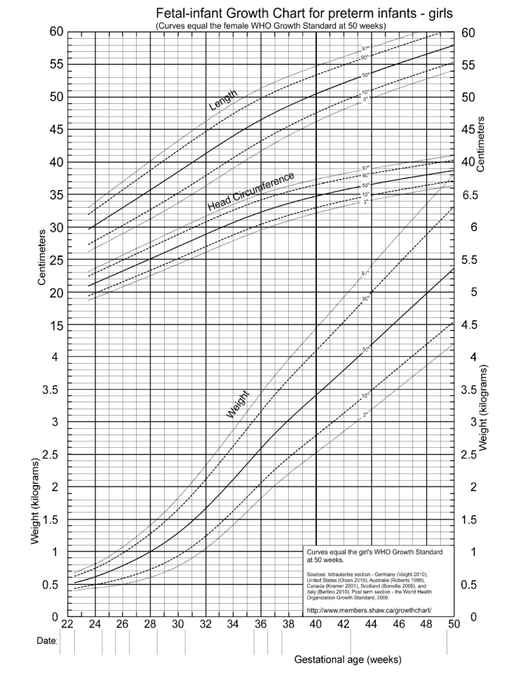
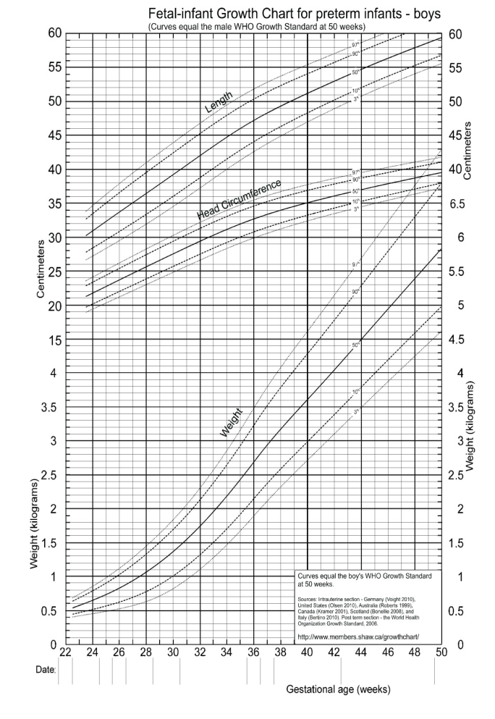
Gender Specific Fenton charts 2013
Based on the recommended growth goal for preterm infants.
Called Standard or prescriptive charts.
Gender Specific.
Equivalent to the WHO growth charts at 50 weeks gestational, so no change in centile when transitioning.

Slide 11
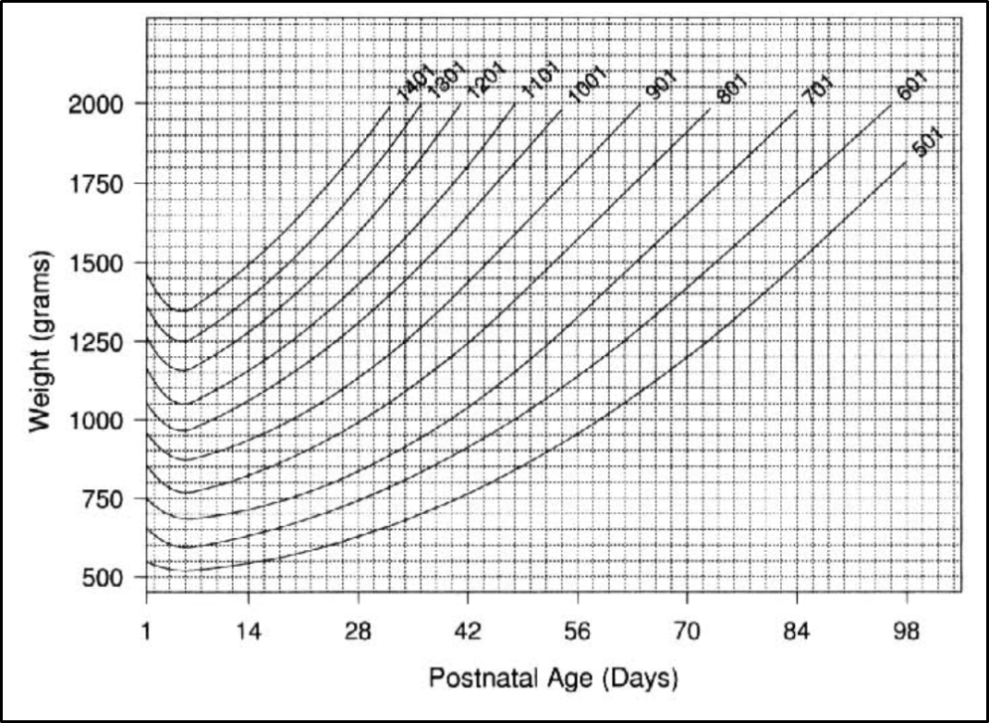
Ehrenkranz Post Natal Growth Charts
Longitudinal curves represent postnatal growth
Portray how babies grow after birth
Allow for the initial postnatal weight loss
seen in newborn
Also called Reference (descriptive) curve

Slide 12
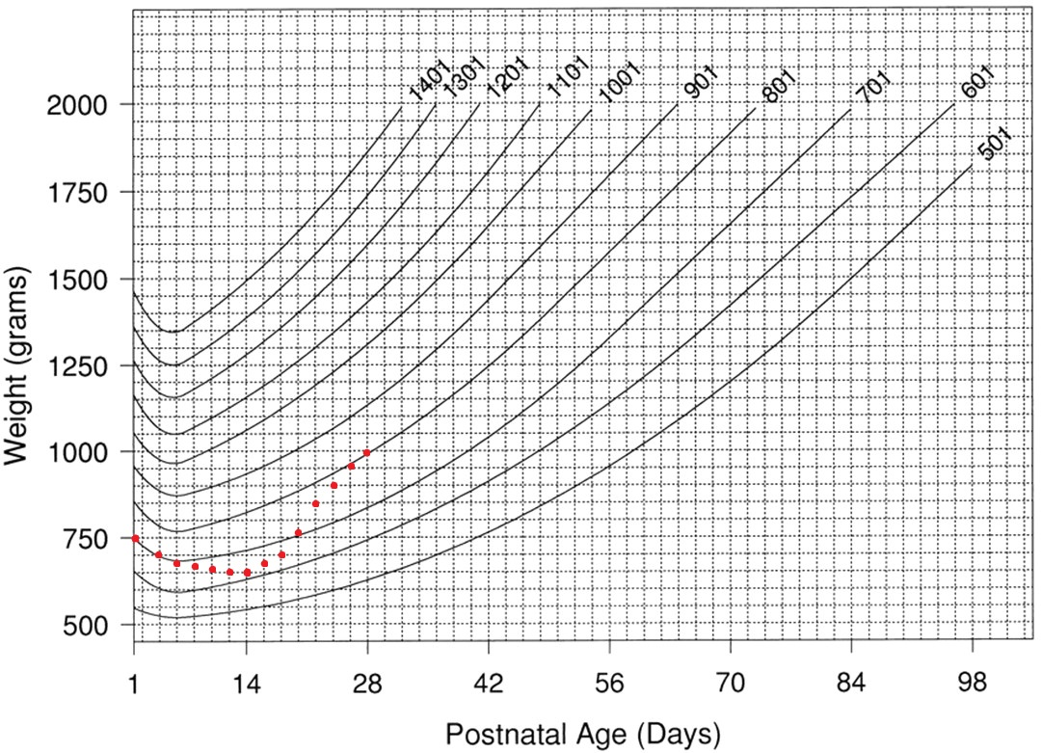
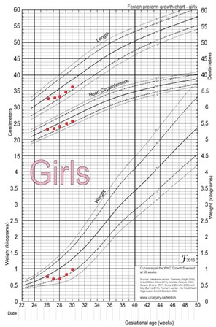
Plotting Growth of 26 weeks 750 grams, for first 28 days

Slide 13
Reasons For Poor Growth & Management
Reasons For Poor Growth | Management
Inadequate protein &/ or caloric intake | Fortification of human milk to provide 120 Kcal / kg /day & 3.5 – 4 gram/kg / day protein
Cold stress | KMC
Anemia | Correction of symptomatic anemia
Occult Infection Hyponatremia | Investigate & treat appropriately

Slide 14
Key Messages
VLBWs are prone to EUGR
Growth monitoring is essential for all preterm babies.
Monitor on Fenton’s (prescriptive) for classification of nutritive status at birth
Monitor on Ehrenkranz (descriptive) charts for postnatal growth
Growth charts help you to monitor faltering and effectiveness of interventions

